Slide 1
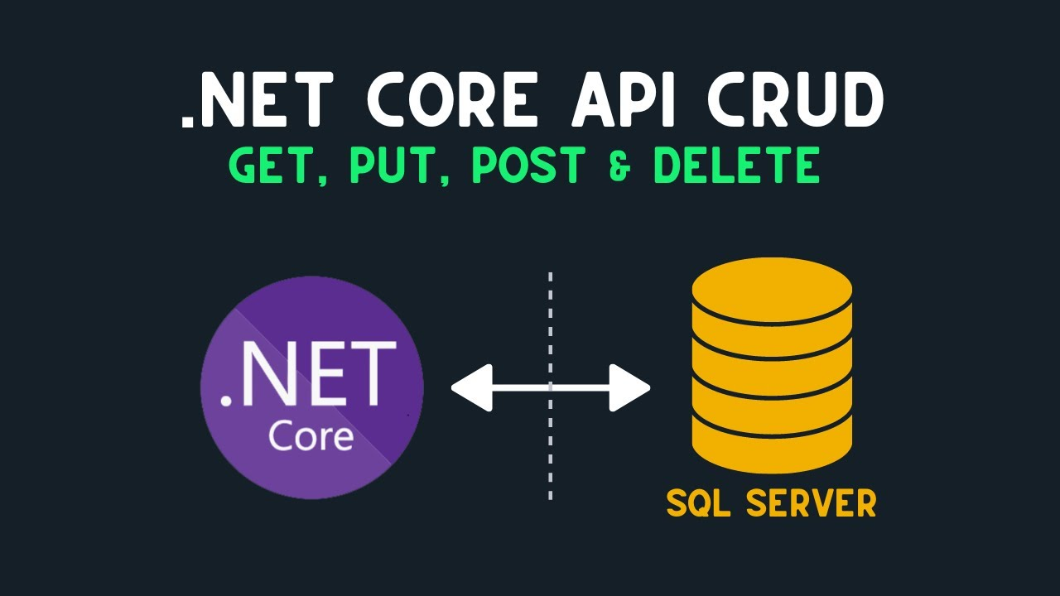

Slide 2
Prerequired
Visual Studio 2022 with ASP.NET and web development
SQL Server
SSMS

Slide 3
CRUD Operations in a Restfull API
Create = Post
Read = Get
Update = Put
Delete = Delete

Slide 4
Nuget Package
Microsoft.EntityFrameworkCore
Microsoft.EntityFrameworkCore.Tool
Microsoft.EntityFrameworkCore.SQLServer

Slide 5
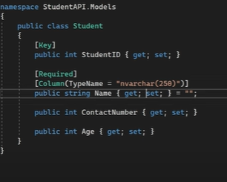
Model Create
Create a Folder with name Models
Create Student.cs Class
Add corresponding properties

Slide 6
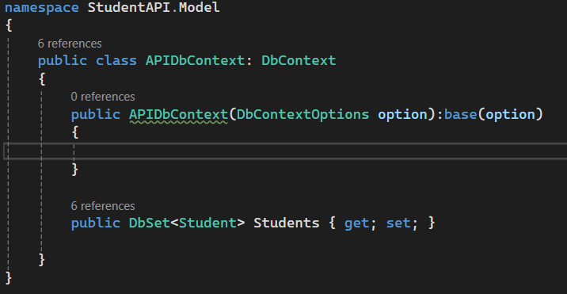



DbContext Class
Add new File named APIDbContext
This act as a middleware actual database and model class
In this mention which are need to in a database after migration
Table name is Student

Slide 7
Create Controllers

Slide 8
Dependency Injection of DbContext Class in Program.cs
//Dependency Injection of DbContext Class
builder.Services.AddDbContext<AppDbContext>(options =>
options.UseSqlServer(builder.Configuration.GetConnectionString("DevConnection")));
Connection String
"ConnectionStrings": { "DevConnection" : "Server=(local)\\sqlexpress;Database=DBStudent;Trusted_Connection=True;TrustServerCertificate=True;Encrypt=True;MultipleActiveResultSets=True;Connection Timeout=30;" }

Slide 9
DB Migration
Open Package manager consol
Build before execute command
Add-Migration “Initial Create”
Update-database

